Slide 1
INTERNSHIP PRESENTATION
Data Analytics Job Simulation Internship
Interns of Industry
Presented by: Abhishek Kumar | Roll No. 2410030904 | Semester V | Section 9
Internship Duration: 4 June 2026 – 2 July 2026
Interns of Industry | Data Analytics Job Simulation Internship 1

Slide 2
Internship Overview
01
Organization
Internship
Duration
Interns of Industry (IOI Labs)
Data Analytics Job Simulation Internship
4 June 2026 – 2 July 2026
Focus Area
Working Approach
Practical data analytics tasks involving exploratory analysis, risk profiling, AI-based delinquency prediction, business reporting and collections strategy.
Hands-on, project-oriented learning with emphasis on transforming data into useful business insights and actionable decisions.
Interns of Industry | Data Analytics Job Simulation Internship 2

Slide 3
Objectives of the Internship
02
• Understand the practical workflow of data analytics.
• Perform exploratory data analysis to identify patterns and trends.
• Build risk profiles from relevant business data.
• Explore AI-based approaches for predicting delinquency.
• Communicate findings through business reports and data storytelling.
• Understand how analytics can support an AI-driven collections strategy.
Interns of Industry | Data Analytics Job Simulation Internship 3

Slide 4
Project / Task 1: Exploratory Data Analysis
03
What was covered
Risk Profiling
Exploration of available data to understand its structure, distributions, patterns, missing values and business-relevant relationships.
Grouping and interpreting records based on relevant risk indicators to support better prioritization and decision-making.
Typical Analytics Workflow
Data loading → data quality checks → descriptive statistics → visualization → pattern identification → risk interpretation → business insights.
Interns of Industry | Data Analytics Job Simulation Internship 4

Slide 5
Project / Task 2: Predicting Delinquency with AI
04
Problem
Data Preparation
AI / ML Approach
Identify patterns that may indicate a higher likelihood of delinquency.
Clean data, handle missing values where applicable, select useful features and prepare data for modelling.
Use a suitable classification workflow to estimate delinquency risk and evaluate model performance.
Business Value
A predictive approach can help prioritize accounts, focus collection efforts and support more informed, data-driven decisions. Actual model metrics should be reported from the internship dataset/results.
Interns of Industry | Data Analytics Job Simulation Internship 5

Slide 6
Project / Task 3: Business Report & Data Storytelling
05
• Convert analytical findings into a clear business narrative.
• Use charts and summaries to communicate important trends.
• Highlight high-priority risk segments and possible collection implications.
• Present insights in a way that can be understood by non-technical stakeholders.
• Connect analytical observations with practical business actions.
Interns of Industry | Data Analytics Job Simulation Internship 6

Slide 7
Project / Task 4: AI-driven Collections Strategy
06
1. Identify
2. Prioritize
3. Act
Use data and risk indicators to identify accounts requiring attention.
Rank or segment cases so collection resources can focus on higher-priority situations.
Use insights to support appropriate collection actions and communication strategies.
4. Monitor
5. Improve
Track outcomes and refine the strategy using updated data.
Continuously improve decisions through analytics and model feedback.
Interns of Industry | Data Analytics Job Simulation Internship 7

Slide 8
Tools & Skills Relevant to the Work
07
Python
Pandas / NumPy
Visualization
Data handling, analysis and automation using Python-based workflows.
Data cleaning, transformation, calculations and structured analysis.
Charts and plots for exploring patterns and communicating insights.
Machine Learning
Data Storytelling
Business Analytics
Classification-oriented workflow for delinquency prediction, where applicable.
Turning analytical outputs into concise business reports and recommendations.
Risk prioritization and analytics-supported collections strategy.
Interns of Industry | Data Analytics Job Simulation Internship 8

Slide 9
Key Learning Outcomes
08
• Developed a practical understanding of the end-to-end data analytics process.
• Improved ability to inspect, clean and interpret structured business data.
• Learned how exploratory analysis can support risk profiling.
• Understood the role of AI / machine learning in delinquency prediction.
• Improved data visualization and business storytelling skills.
• Learned how analytics can be connected to operational decision-making.
Interns of Industry | Data Analytics Job Simulation Internship 9

Slide 10
Conclusion
09
Overall Experience
The internship provided a practical exposure to data analytics through exploratory analysis, risk profiling, AI-based delinquency prediction, business reporting and an AI-driven collections strategy.
Career Relevance
Next Step
The experience strengthened analytical thinking, problem solving and business-focused data interpretation.
Continue developing skills in Python, SQL, visualization, statistics and machine learning through real datasets and projects.
Interns of Industry | Data Analytics Job Simulation Internship 10

Slide 11
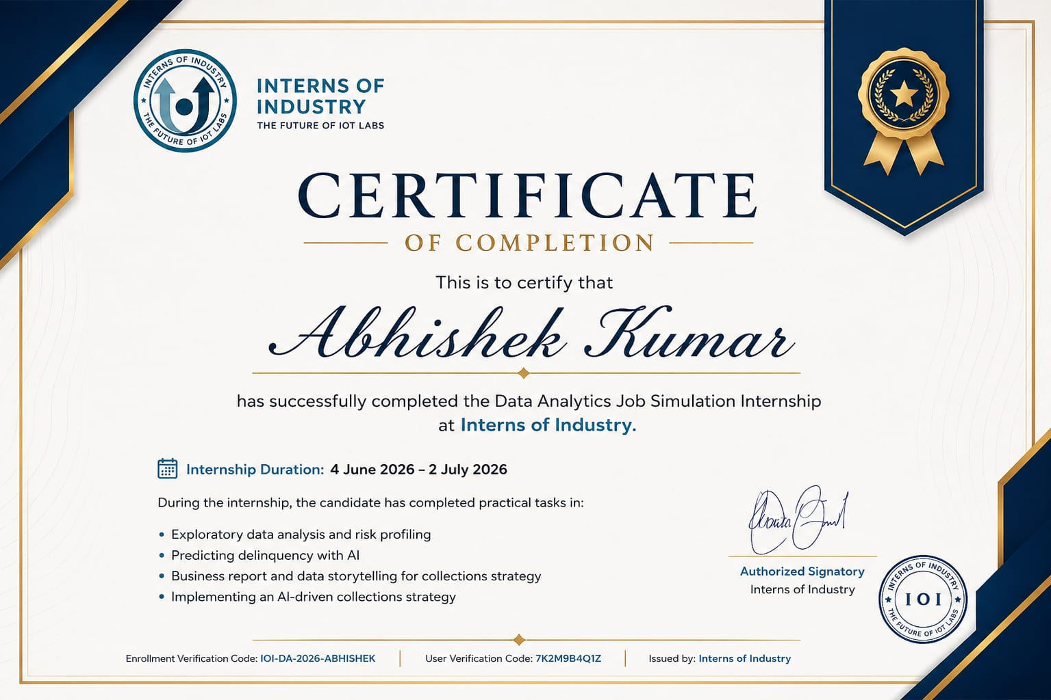
Internship Certificate
10
Interns of Industry | Data Analytics Job Simulation Internship 11

Slide 12
THANK YOU
Abhishek Kumar
Data Analytics Job Simulation Internship | Interns of Industry
Interns of Industry | Data Analytics Job Simulation Internship 12

